Slide 1
Work experience presentation
Cameron Hillier

Slide 2

The company
Red Group Solutions is an software and IT solutions development company.
Based in Farnborough
Founded in 2009
The company is run by 4 directors.
The company's employees are frequently out of the office working on-site with clients.

Slide 3
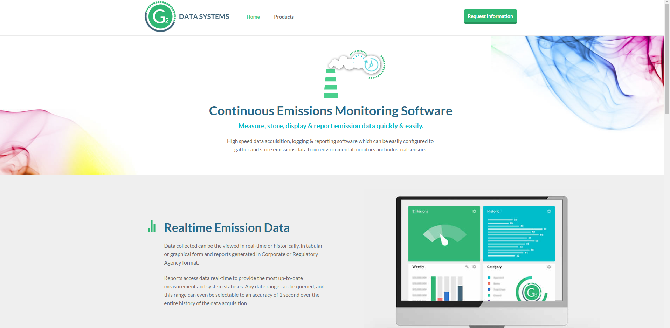
Work carried out
Whilst at the placement I completed several tasks.
The goals of these tasks mostly revolved around finding problems with, and improving the g2 data systems website.
Progress was monitored using
Trello, a web-based project
Management tool.

Slide 4
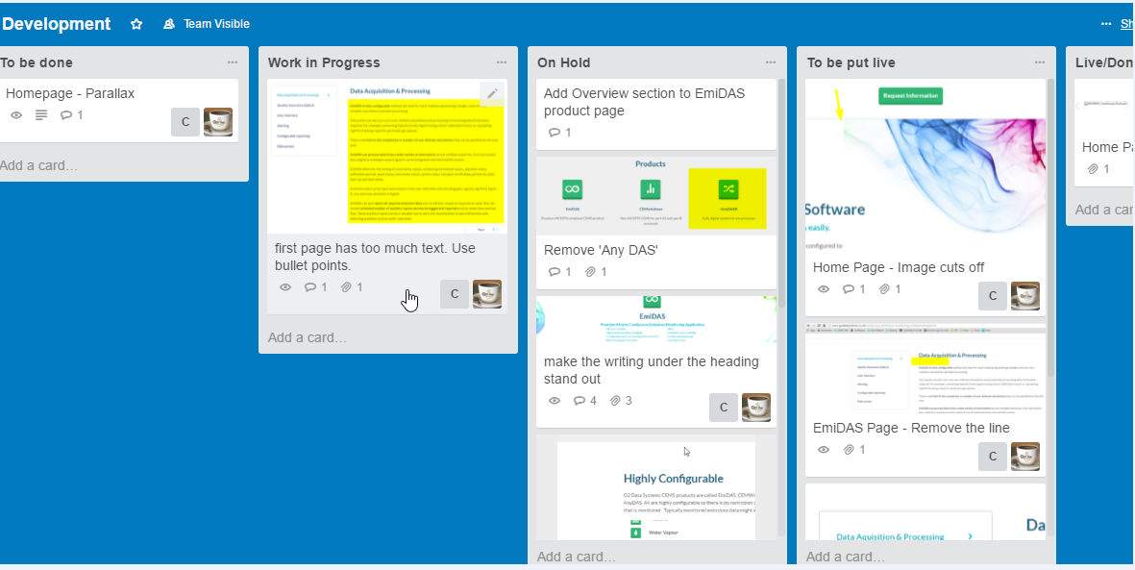
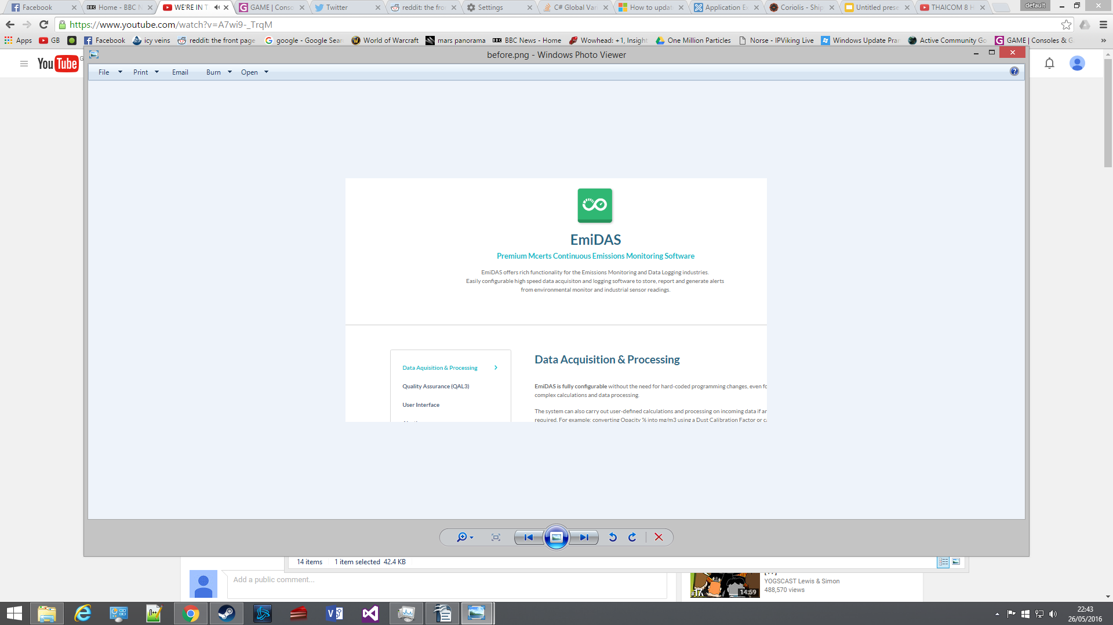
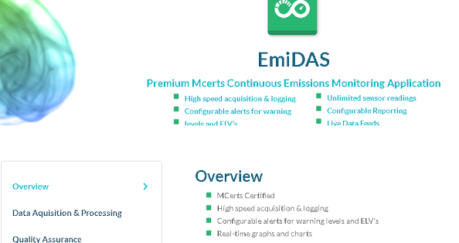
Work carried out cont.
The tasks that were set included:
Added objects to the website’s menu.
Edited images on the website.
Changed the design of, and animating the text block shown below.

Slide 5
Achievements
By the end of the placement I had achieved the following:
Critiqued and suggested improvements to the website.
Implemented suggested changes to the website.
Managed the progress of the changes using trello.
Learnt how to use some interesting website elements in html/css/js, such as javascript carousels.

Slide 6
Any questions?
It should include:
A description of the tasks/project to which the student was assigned
An indication of the goals that were set
An account of what was actually accomplished
Difficulties or problems encountered (if any)
Some assessment of achievements

